Slide 1
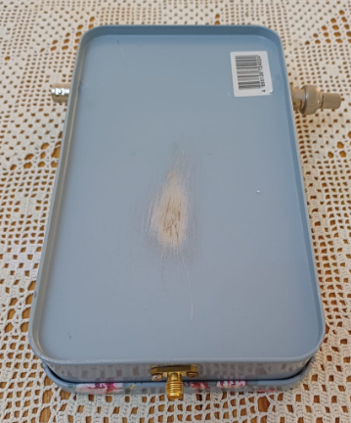
50dB RF Power Tap
By ZS6BVR

Slide 2
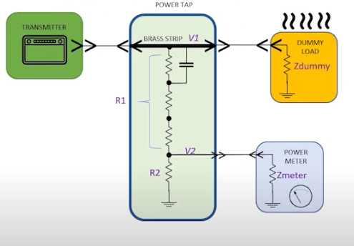
Design

Slide 3
Calculations
 |  |  |  | RF Tap
 |  | Zin | 50 | OHM
 |  | Power | 100 | W
 | Vs | Voltage | 70.71067812 | V |  |  | 100 | W
 | VR1 |  | 70.63996744
 | R1
 | R2 | Zout | 50 | OHM
 | Power Output |  | 0.1 | mW | 0.0001 | W
 | VR2 | Voltage | 0.07071 | V | 0.070710678 | V | 0.0001 | W
 |  | VR1/VR2 |  | 999 |  | =R1/R2
 |  | R1 |  | 49950
 |  | R | 49948 |  | 2
Resistors |  | 47000 | 2200 | 680 | 68 |  | In Series

Slide 4
Power Levels
Power | dBm | Frequency |  | Attenuation |  |  | O/P with 100W |  | O/P with 10W |  | O/P with 5W |  | O/P with 1W
100W | 50 | 1 | MHz | 61.68 | dB |  | -11.68 | dBm | -14.68 | dBm | -24.68 | dBm | -31.68 | dBm
50W | 47 | 1.8 | MHz | 58.63 | dB |  | -8.63 | dBm | -11.63 | dBm | -21.63 | dBm | -28.63 | dBm
5W | 37 | 3 | MHz | 53.89 | dB |  | -3.89 | dBm | -6.89 | dBm | -16.89 | dBm | -23.89 | dBm
1W | 30 | 3.5 | MHz | 52.46 | dB |  | -2.46 | dBm | -5.46 | dBm | -15.46 | dBm | -22.46 | dBm
 |  | 5 | MHz | 51.37 | dB |  | -1.37 | dBm | -4.37 | dBm | -14.37 | dBm | -21.37 | dBm
 |  | 7 | MHz | 52.63 | dB |  | -2.63 | dBm | -5.63 | dBm | -15.63 | dBm | -22.63 | dBm
 |  | 9 | MHz | 54.22 | dB |  | -4.22 | dBm | -7.22 | dBm | -17.22 | dBm | -24.22 | dBm
 |  | 10 | MHz | 55.37 | dB |  | -5.37 | dBm | -8.37 | dBm | -18.37 | dBm | -25.37 | dBm
 |  | 14 | MHz | 55.51 | dB |  | -5.51 | dBm | -8.51 | dBm | -18.51 | dBm | -25.51 | dBm
 |  | 17 | MHz | 55.68 | dB |  | -5.68 | dBm | -8.68 | dBm | -18.68 | dBm | -25.68 | dBm
 |  | 20 | MHz | 55.73 | dB |  | -5.73 | dBm | -8.73 | dBm | -18.73 | dBm | -25.73 | dBm
 |  | 21 | MHz | 56.02 | dB |  | -6.02 | dBm | -9.02 | dBm | -19.02 | dBm | -26.02 | dBm
 |  | 24 | MHz | 55.57 | dB |  | -5.57 | dBm | -8.57 | dBm | -18.57 | dBm | -25.57 | dBm
 |  | 28 | MHz | 56.1 | dB |  | -6.1 | dBm | -9.1 | dBm | -19.1 | dBm | -26.1 | dBm
 |  | 29 | MHz | 55.94 | dB |  | -5.94 | dBm | -8.94 | dBm | -18.94 | dBm | -25.94 | dBm
 |  | 50 | MHz | 55.74 | dB |  | -5.74 | dBm | -8.74 | dBm | -18.74 | dBm | -25.74 | dBm
 |  | 51 | MHz | 55.73 | dB |  | -5.73 | dBm | -8.73 | dBm | -18.73 | dBm | -25.73 | dBm
 |  | 52 | MHz | 55.85 | dB |  | -5.85 | dBm | -8.85 | dBm | -18.85 | dBm | -25.85 | dBm
 |  | 53 | MHz | 55.97 | dB |  | -5.97 | dBm | -8.97 | dBm | -18.97 | dBm | -25.97 | dBm
 |  | 54 | MHz | 55.99 | dB |  | -5.99 | dBm | -8.99 | dBm | -18.99 | dBm | -25.99 | dBm
 |  | 144 | MHz | 58.68 | dB |  | -8.68 | dBm | -11.68 | dBm | -21.68 | dBm | -28.68 | dBm
 |  | 145 | MHz | 58.67 | dB |  | -8.67 | dBm | -11.67 | dBm | -21.67 | dBm | -28.67 | dBm

Slide 5
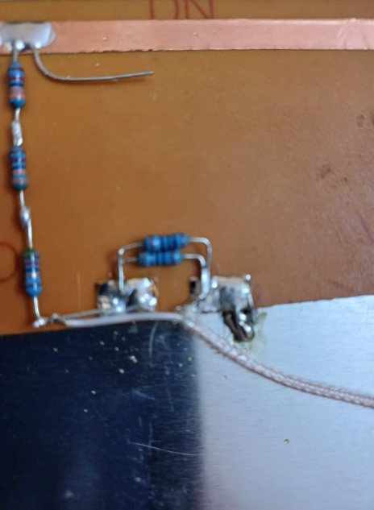
Closeup view

Slide 6
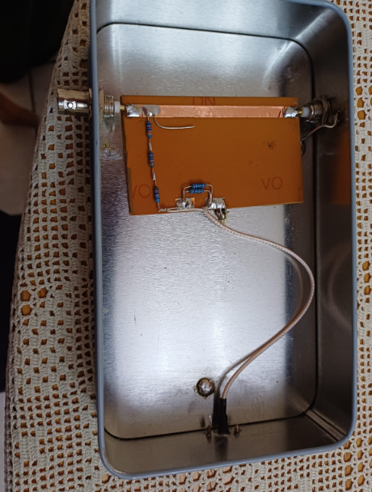
Nico builds this

Slide 7
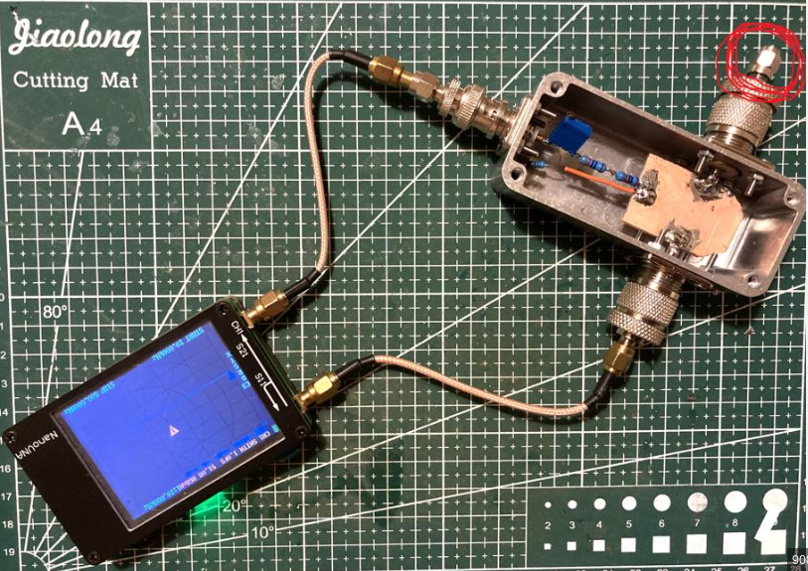
Nano VNA Measurement

Slide 8
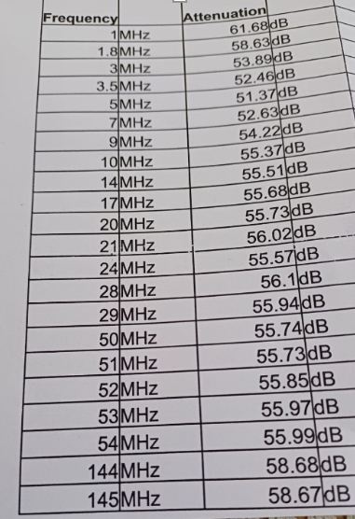
Results

